Slide 1
Banking - Payments UPI

Slide 2
UPI – Unified Payments Interface
Unified Payments Interface (UPI) is an instant payment system developed by the National Payments Corporation of India (NPCI), an RBI regulated entity. UPI is built over the IMPS infrastructure and allows you to instantly transfer money between any two parties' bank accounts.
Unified Payments Interface (UPI) is a system that powers multiple bank accounts into a single mobile application (of any participating bank), merging several banking features, seamless fund routing & merchant payments into one hood. It also caters to the “Peer to Peer” collect request which can be scheduled and paid as per requirement and convenience.
SEBI has now allowed investors to use their UPI (Unified Payment Interface) ID as a payment option for IPO issues. An applicant can use an existing UPI ID, which is linked to his or her bank account. This makes the entire process secure and straightforward.

Slide 3
Features of UPI
Immediate money transfer through mobile device round the clock 24*7 and 365 days.
Single mobile application for accessing different bank accounts.
Single Click 2 Factor Authentication – Aligned with the regulatory guidelines, yet provide for a very strong feature of seamless single payment.
Virtual address of the customer for Pull & Push provides for incremental security with the customer not required to enter the details such as Card no, Account number, IFSC etc.
Best answer to Cash on Delivery hassle, running to an ATM or rendering an exact amount.
Utility Bill Payments, Over the Counter Payments, Barcode (Scan and Pay) based payments

Slide 4
Participants in UPI
Participants in UPI
Payer PSP (Payment Service Provider)
Payee PSP (Payment Service Provider)
Remitter Bank
Beneficiary Bank
NPCI
Bank Account Holders
Merchants

Slide 5
UPI QR Code
QR (Quick Response) Code used for receiving payment from UPI APPs is called UPI QR Code. UPI QR Code contains information related to payment receiver, Payers scans with UPI mobile app, the UPI QR Code of receiver to make payment. Payment is debited from payer account by the payer bank and payer bank sends credit details to receiver bank and receiver bank credit the amount into the payers bank account. After amount is credited into payers account, payer can use the amount to make payment or can withdraw the amount.
Features of QR Code
Instant Credit to your Bank Account
No Transaction Charges
No Maintenance Charges
No Swipe Machine Required
No Smart Phone required to receive UPI payments
No need to share Mobile Number
No need to send payment request

Slide 6

UPI QR Code
Advantages of QR Code
It stores a large volume of data.
It can be scanned from a screen not just a piece of paper.
It can be read even if part of the code is damaged.
It is safer because information can be encrypted.
Characteristics of QR Code
The QR code stands out with its three small squares placed in the lower and upper left corners and upper right corner. The overall code has a square shape composed of a matrix of small squares. The number of small squares per side can vary, e.g. 33 x 33 or 177 x 177.

Slide 7
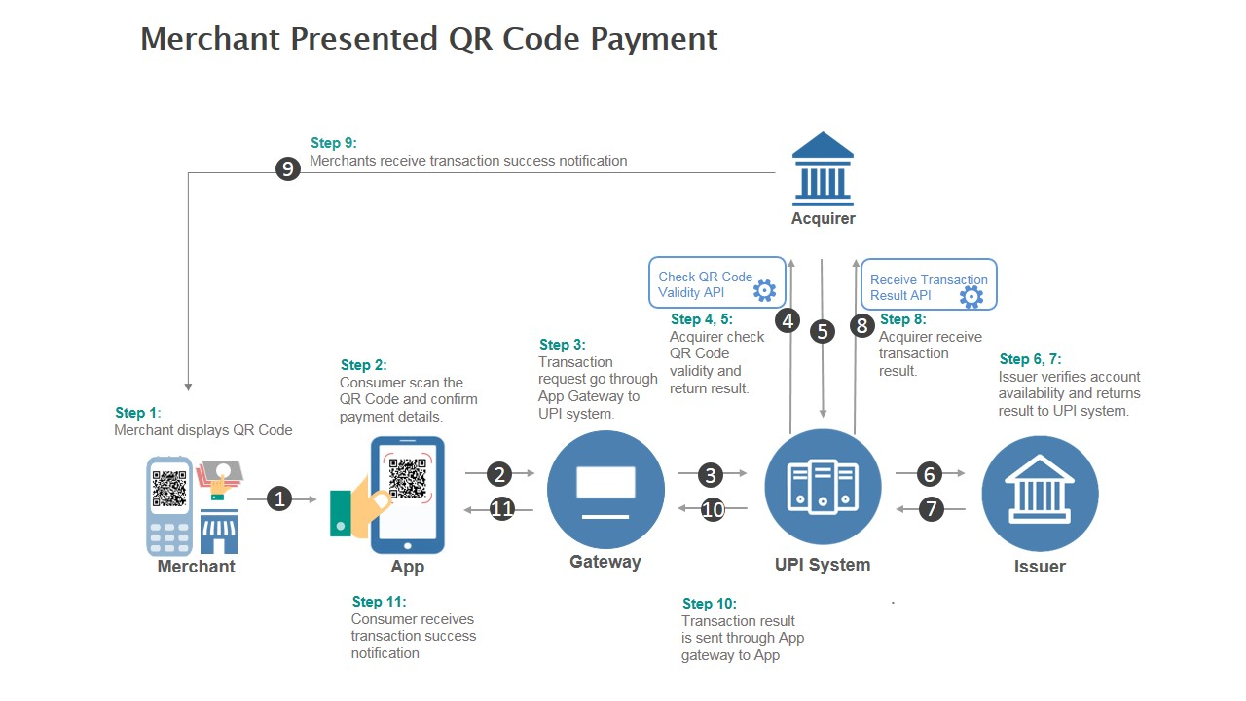
NACH Form

Slide 8
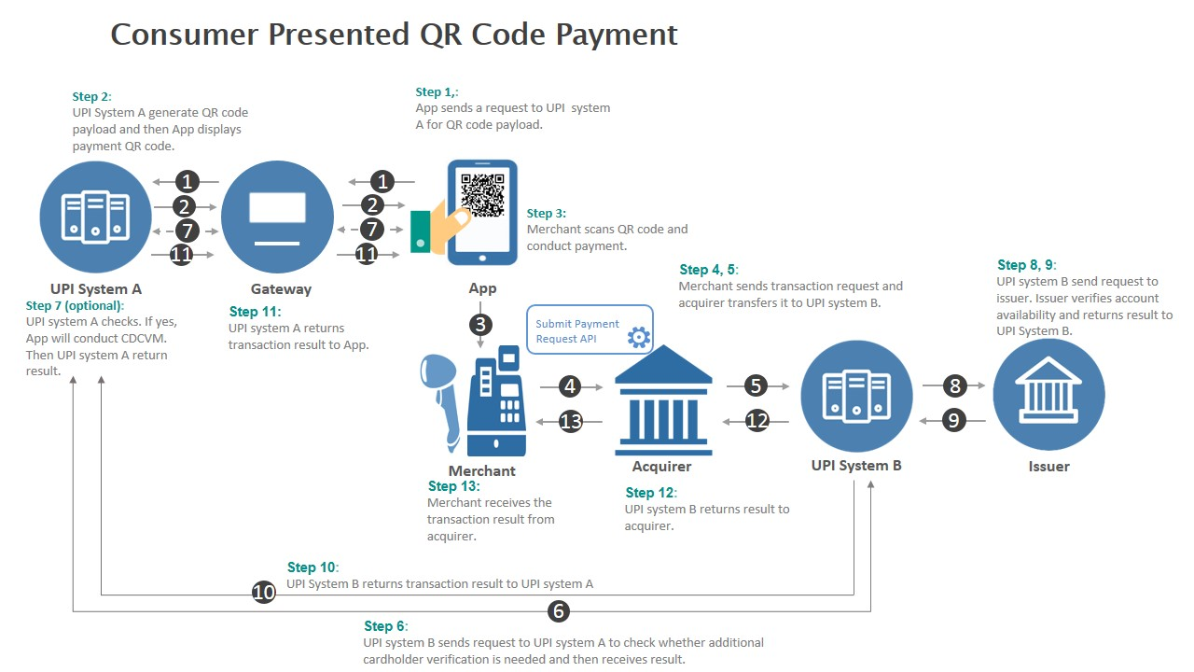
NACH Form

Slide 9
UPI PIN
UPI-PIN (UPI Personal Identification Number) is a 4-6 digit pass code you create/set during first time registration with this App. You have to enter this UPI-PIN to authorize all bank transactions.
Note: Please do not share your UPI-PIN with anyone. BHIM does not store or read your UPI-PIN details and your bank's customer support will never ask for it.
UPI ID
UPI ID also referred to as Virtual Payment Address (VPA), is a unique address that you create to send and receive money. With UPI ID, you do not need to feed in the bank account details. Just like your email ID, your UPI ID is also unique. When you register early, you stand a chance to register with your choice of name. This is critical as once the name is taken you will not be able to get the same one and may have to settle for something else

Slide 10
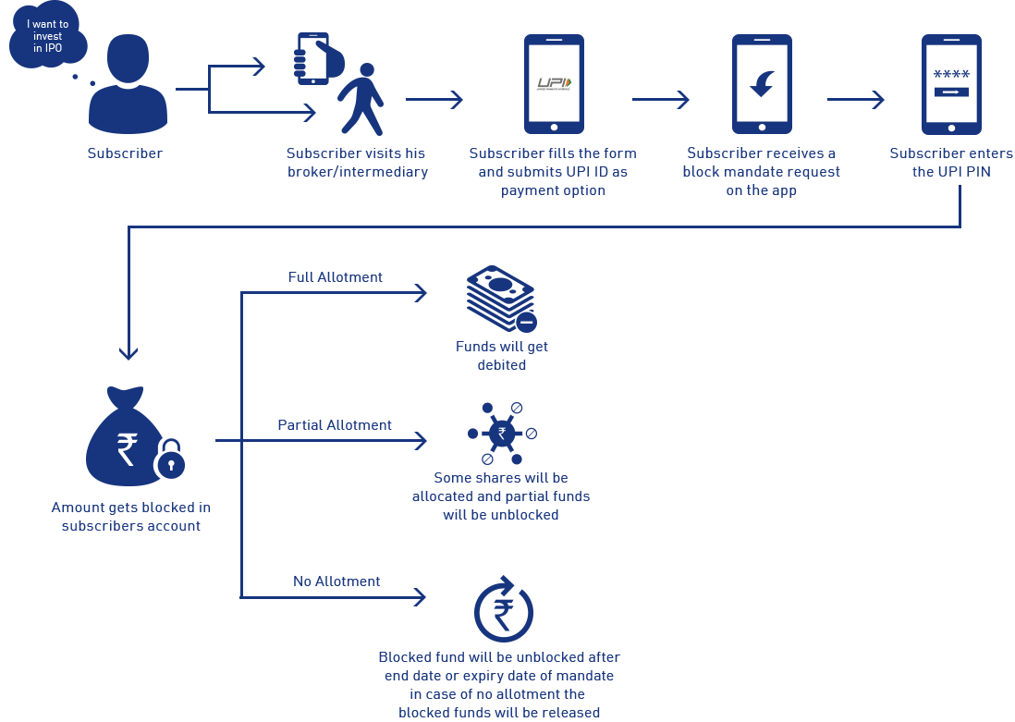
IPO Workflow

Slide 11
Video Link
IPO workflow IN UPI - https://www.youtube.com/watch?v=UJ394m2Q3rg&t=257s

